Slide 1
Nuclear Energy 101
The American Nuclear Society
Credit: W. D. Pointer, Ph. D

Slide 2
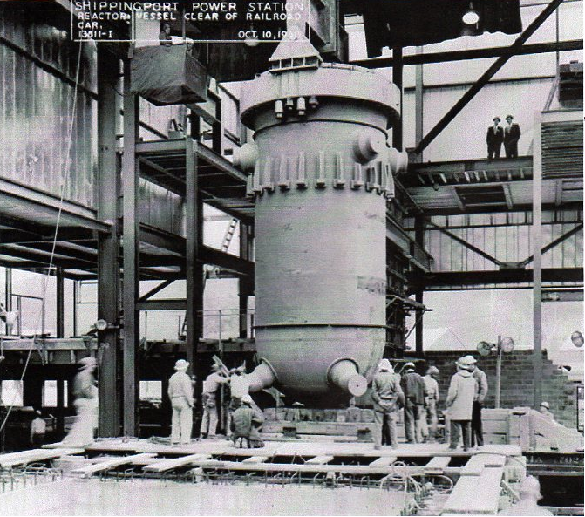
Shippingport Reactor Vessel

Slide 3
We’re going to wrestle with some big questions

Slide 4
HOW?
We’re going to wrestle with some big questions

Slide 5
We’re going to wrestle with some big questions
What if?

Slide 6
We’re going to wrestle with some big questions
When?

Slide 7
WHY?
We’re going to wrestle with some big questions

Slide 8

WHY?

Slide 9
Let’s get started

Slide 10
Why do we need more energy?

Slide 11
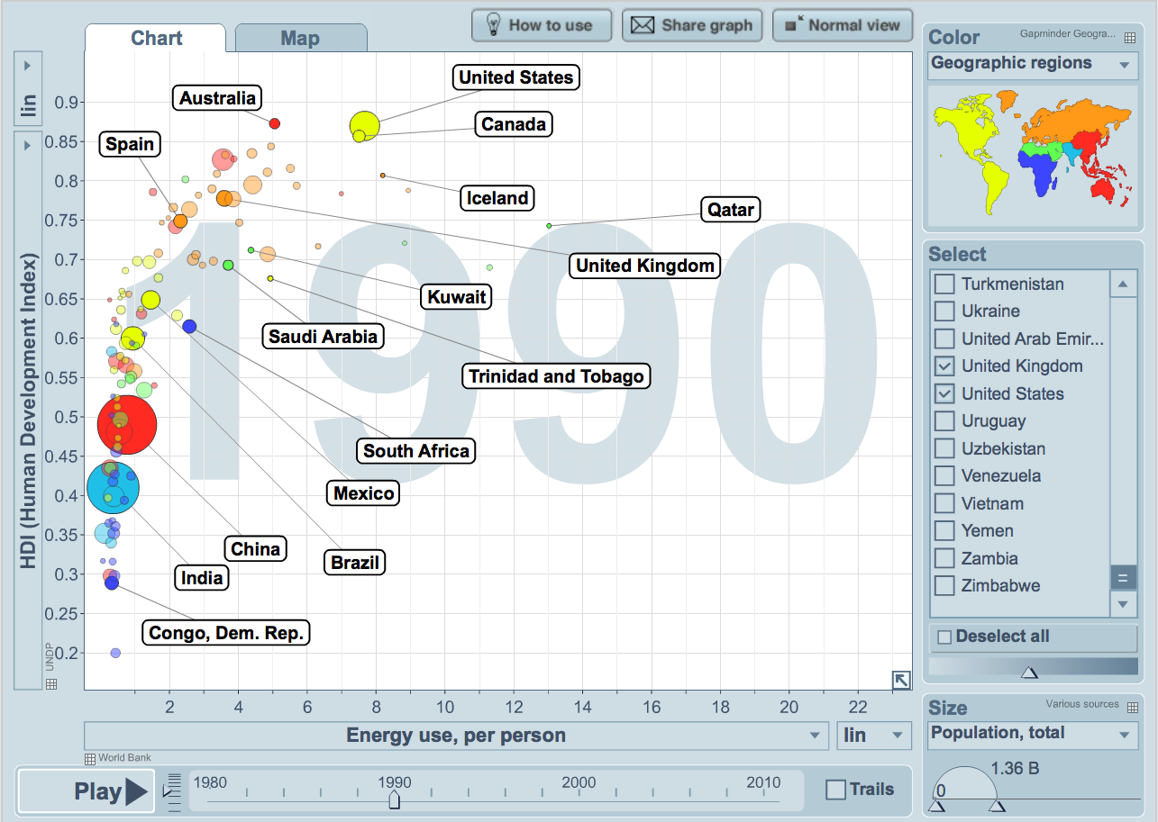
Electricity Enables Human Development
Energy use is shown in Tonnes of Oil Equivalent (or TOE)
Visualization from Gapminder World, powered by Trendalyzer from www.gapminder.org

Slide 12
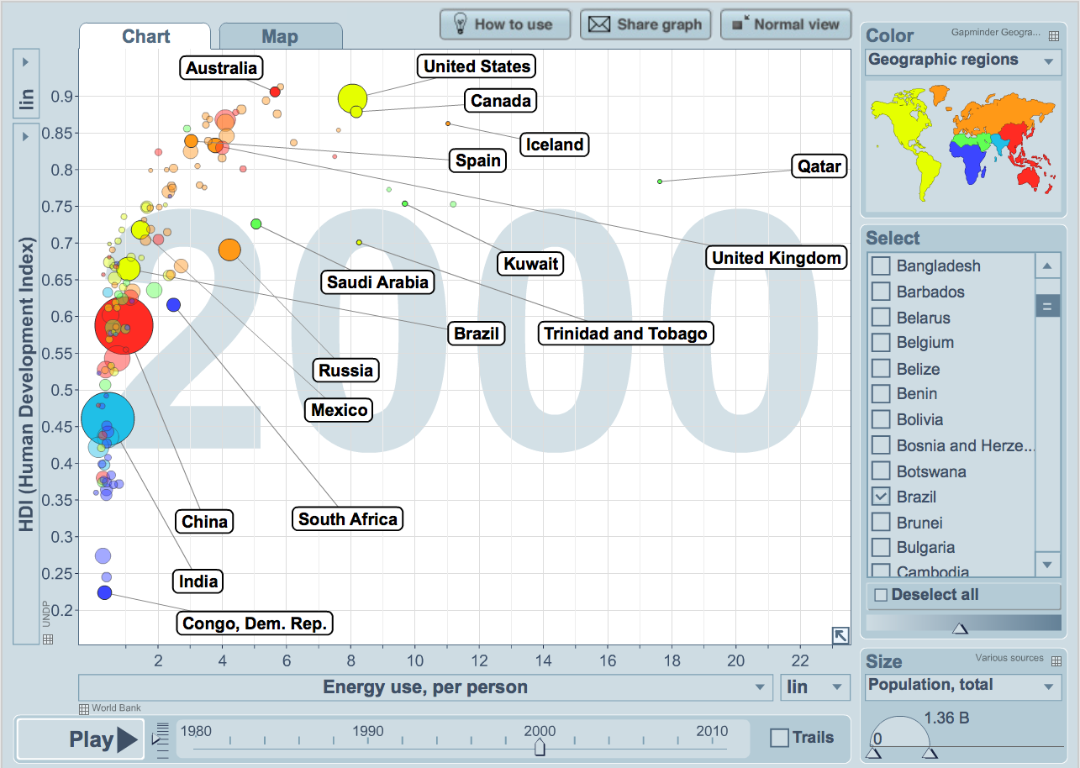
Electricity Enables Human Development
Energy use is shown in Tonnes of Oil Equivalent (or TOE)
Visualization from Gapminder World, powered by Trendalyzer from www.gapminder.org

Slide 13
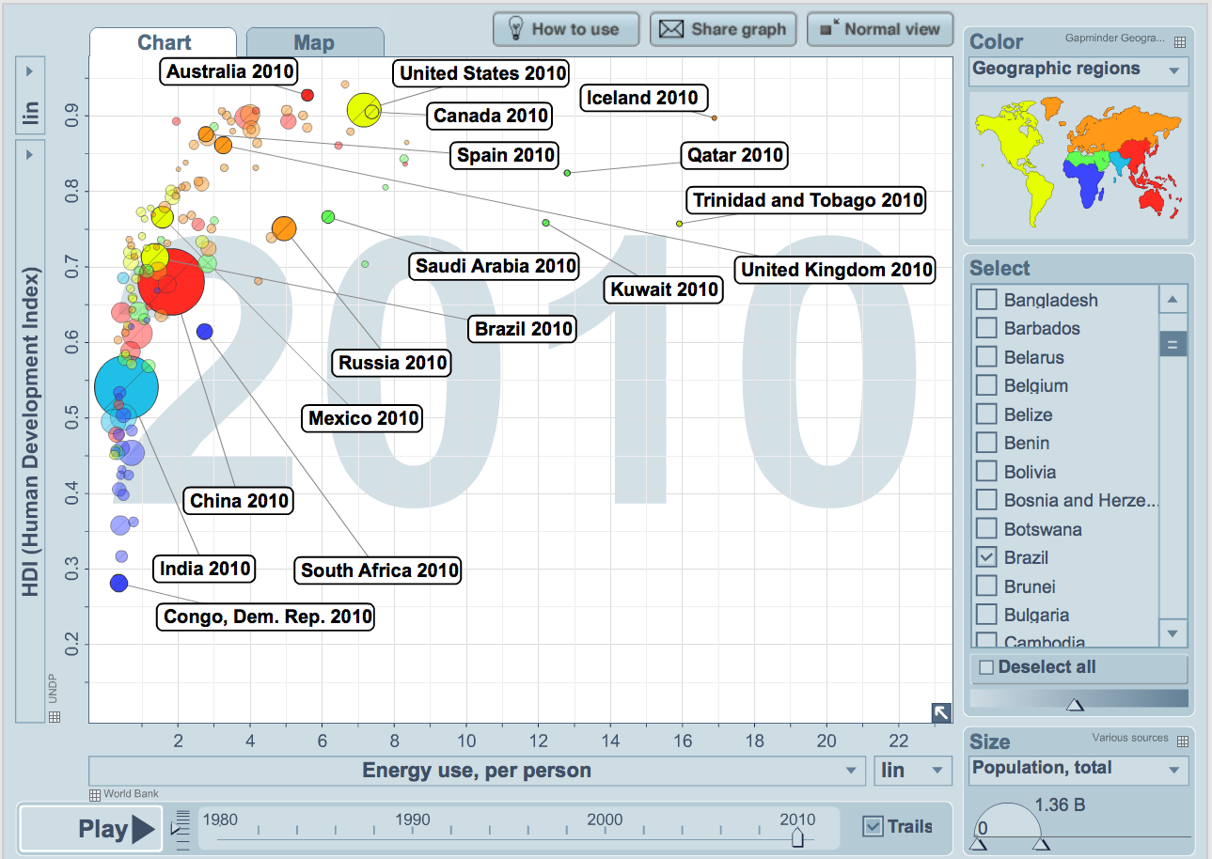
Electricity Enables Human Development
Energy use is shown in Tonnes of Oil Equivalent (or TOE)
Visualization from Gapminder World, powered by Trendalyzer from www.gapminder.org

Slide 14
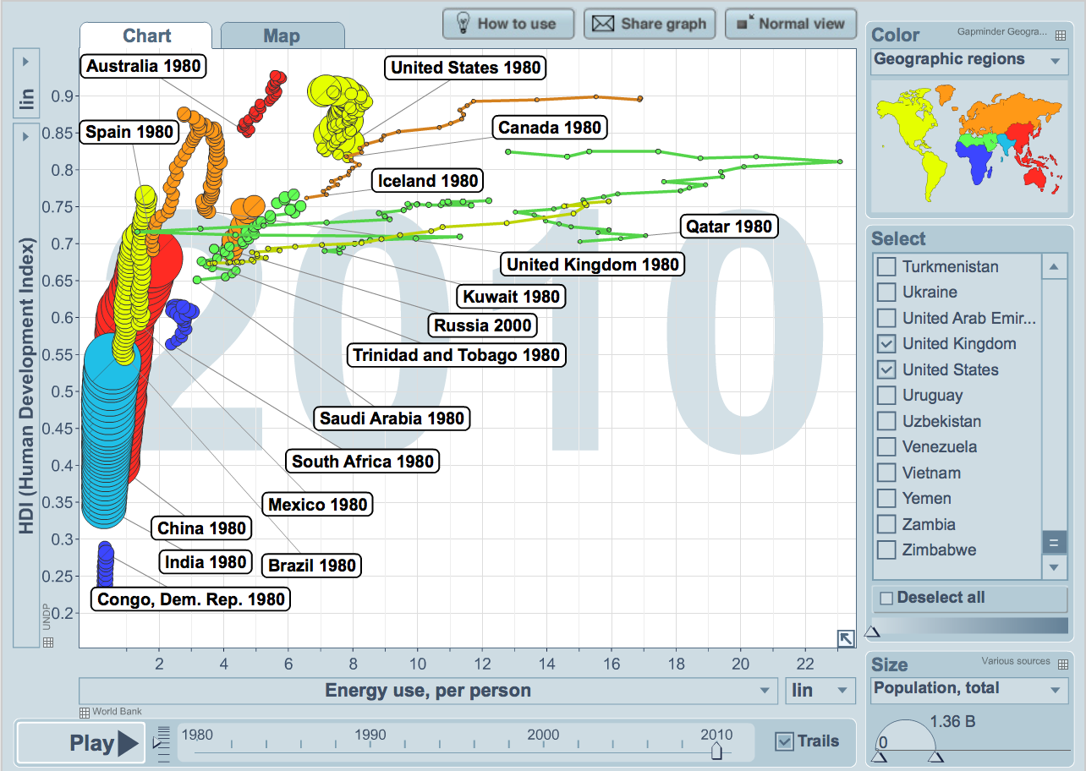
As nations develop they move up and to the right
Energy use is shown in Tonnes of Oil Equivalent (or TOE)
Visualization from Gapminder World, powered by Trendalyzer from www.gapminder.org

Slide 15
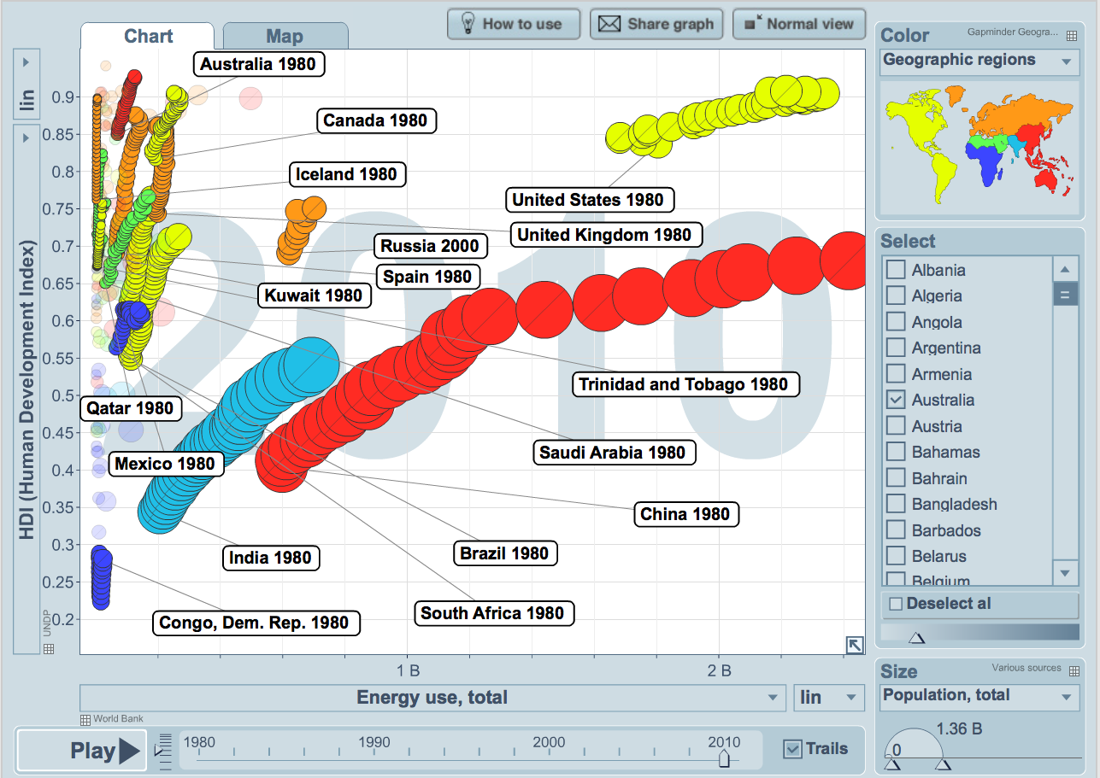
Per Capita Use is Informative, But Can Be Misleading
Energy use is shown in Tonnes of Oil Equivalent (or TOE)
Visualization from Gapminder World, powered by Trendalyzer from www.gapminder.org

Slide 16
Why do we need NUCLEAR energy?

Slide 17
U.S. Electric Generation in 1998
3.620 BILLION Megawatthours Total
Source: Electric Power Annual 2010
U.S. Energy Information Administration

Slide 18
U.S. Electric Generation in 2010
4.125 BILLION Megawatthours Total
Source: Electric Power Annual 2010
U.S. Energy Information Administration

Slide 19
U.S. Electric Generation in 2011
4.105 BILLION Megawatthours Total
13.4% INCREASE since 1998
Source: Electric Power Annual 2010
U.S. Energy Information Administration

Slide 20
Let’s move on to a truly important energy engineering question.

Slide 21
How does your coffee pot work?
Why does the water pour out of your coffee pot’s filter basket into the pot below?
How does the water you put into your coffeepot go from the tank to the filter basket?

Slide 22
Coffee Pots: The Naked Truth
Water absorbs energy
Water’s density decreases with temperature
  Steam’s density is MUCH lower than liquid water
Hot, low density water rises to filter basket
  Added energy enables water to do some useful work
NATURAL CONVECTION
Energy

Slide 23
What does this have to do with NUCLEAR ENERGY?

Slide 24
How is a Power Plant like a Coffee Pot?
Energy
This is worth a closer look.

Slide 25
How is a Power Plant like a Coffee Pot?
Energy
First, we won’t need a coffee pot in a power plant.
Next we should probably look at things from a different angle.

Slide 26

How is a Power Plant like a Coffee Pot?
We need a bigger heat source than a coffee pot’s hot plate.
Now let’s make some electricity!

Slide 27
How is a Power Plant like a Coffee Pot?
Turbine/
Generator
Condenser
How do we control how much electricity we make?

Slide 28
How is a Power Plant like a Coffee Pot?
Turbine/
Generator
Condenser
Pump
How do we control how much electricity we make?

Slide 29
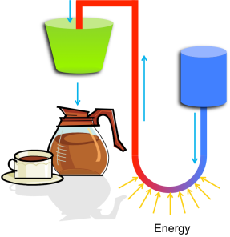
How is a Power Plant like a Coffee Pot?
A closer look at a coal fired power plant.

Slide 30
How is a nuclear power plant different?

Slide 31
It’s the Fuel!
Nuclear power plants use the energy stored in the nucleus of large atoms rather than the energy stored in weaker chemical bonds.

Slide 32

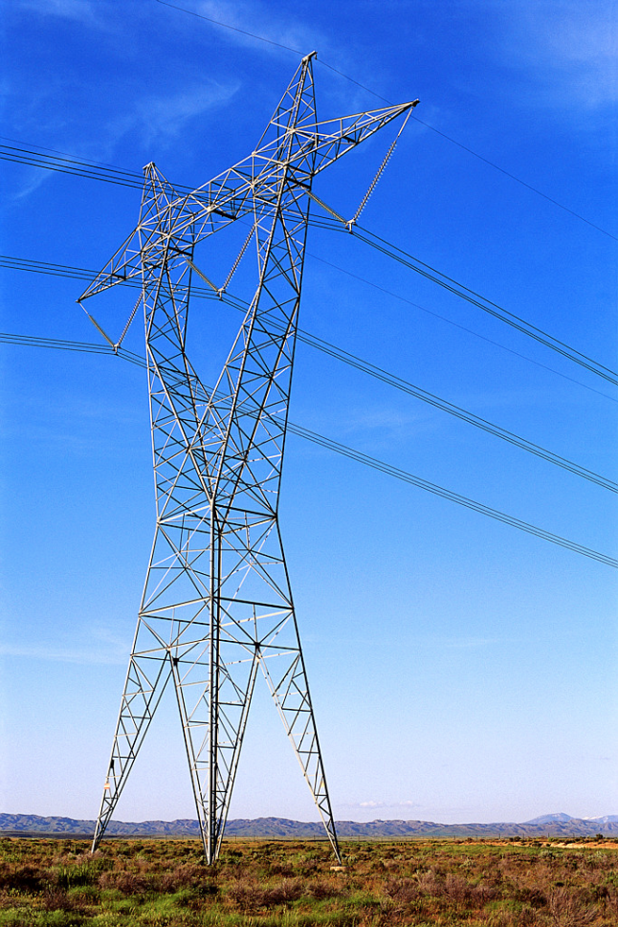
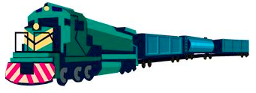
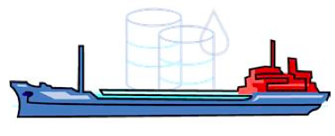
It’s the Fuel!
To Power 1000 Homes
150 Tons of Uranium
2,100,000 Tons of Coal
10,000,000 Barrels of Oil

Slide 33
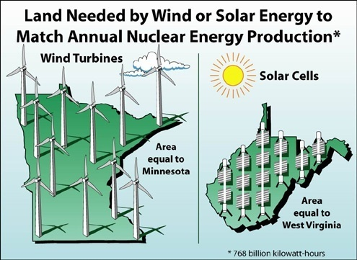

Slide 34

It’s the Fuel!
The spent fuel used to generate all of the energy used in one American’s lifetime would fit in here

Slide 35
What is Nuclear Fission?
If the nucleus of a heavy atom (such as Uranium) absorbs a neutron, the nucleus can become unstable and split.
This is called NUCLEAR FISSION.
Neutron
Uranium
Nucleus
Images: Original art by Dave Pointer

Slide 36
What is Nuclear Fission?
The nucleus splits in two halves and releases some neutrons, and radiation
Images: Original art by Dave Pointer

Slide 37
What is Nuclear Fission?
During fission, a small amount of mass is lost. This mass is transformed into ENERGY, which is also released.
E=mc²
Images: Original art by Dave Pointer

Slide 38
Let’s Build a Nuclear Power Plant

Slide 39
Let’s Build a Nuclear Power Plant
First, ceramic fuel pellets are manufactured from uranium ore

Slide 40
Let’s Build a Nuclear Power Plant
The ceramic fuel pellets are stacked in a column
And sealed inside a metallic alloy case, called the cladding, to form a fuel rod

Slide 41
Let’s Build a Nuclear Power Plant
The fuel rods are grouped together in a regular array or fuel assembly

Slide 42
Let’s Build a Nuclear Power Plant
The fuel rods are grouped together in a regular array or fuel assembly
The fuel assemblies are arranged in a larger regular array or reactor core

Slide 43
Let’s Build a Nuclear Power Plant
The fuel rods are grouped together in a regular array or fuel assembly
The fuel assemblies are arranged in a larger regular array or reactor core
The reactor core is contained inside a heavy steel reactor pressure vessel (RPV)

Slide 44
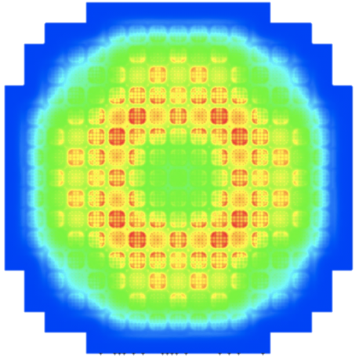
A Reality Check
Fuel Assembly and Reactor Core Design are Complex Engineering Challenges

Slide 45
Let’s Build a Nuclear Power Plant
The fuel rods are grouped together in a regular array or fuel assembly
The fuel assemblies are arranged in a larger regular array or reactor core
The reactor core is contained inside a heavy steel reactor pressure vessel (RPV)

Slide 46
Let’s Build a Nuclear Power Plant
Turbine/
Generator
Condenser
Pump
In a nuclear power plant, the reactor core replaces the burning fossil fuel as the energy source

Slide 47
Let’s Build a Nuclear Power Plant
Turbine/
Generator
Condenser
Pump
Control rods absorb neutrons and are used to stop/start the reaction

Slide 48
Let’s Build a Nuclear Power Plant
Turbine/
Generator
Condenser
Pump
Control rods absorb neutrons and are used to stop/start the reaction

Slide 49
What’s so CRITICAL?
CRITICAL → k=1
  # of Neutrons Produced = # of Neutrons Absorbed
SUB-Critical → k<1
  # of Neutrons Produced < # of Neutrons Absorbed
SUPER-Critical → k>1
  # of Neutrons Produced > # of Neutrons Absorbed

Slide 50
Boiling Water Reactor (BWR)
Turbine/
Generator
Condenser
Pump
39 of the 104 nuclear power plants in the U.S. look like this
They’re called BWRs or Boiling Water Reactors

Slide 51
Pressurized Water Reactor (PWR)
Turbine/
Generator
Condenser
Pump
Most U.S. nuclear power plants are PWRs or Pressurized Water Reactors
Steam is made in a steam generator rather than directly in the reactor core
Pump

Slide 52
PWR Containment
Turbine/
Generator
Condenser
Pump
Pump
The entire reactor sits inside a large concrete and steel containment building

Slide 53
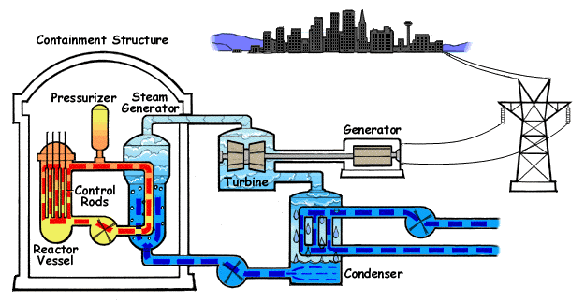
Pressurized Water Reactor

Slide 54
BWR Containment
Turbine/
Generator
Condenser
Pump
The entire reactor sits inside a large concrete and steel containment building

Slide 55
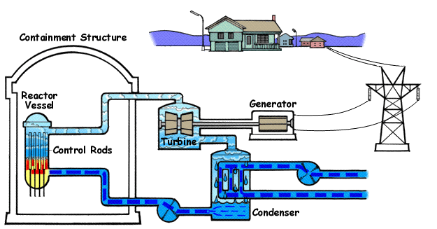
Boiling Water Reactor

Slide 56
POP QUIZ!!!

Slide 57
Where is the Reactor?

Slide 58
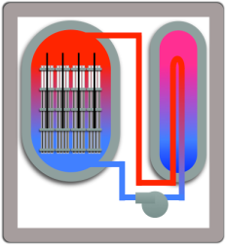
Where is the Reactor?

Slide 59
Then what are these?

Slide 60
Cooling Towers
They chill the cold water used by the condenser.

Slide 61
BWR Containment
Turbine/
Generator
Condenser
Pump
The entire reactor sits inside a large concrete and steel containment building

Slide 62
Boiling Water Reactor

Slide 63
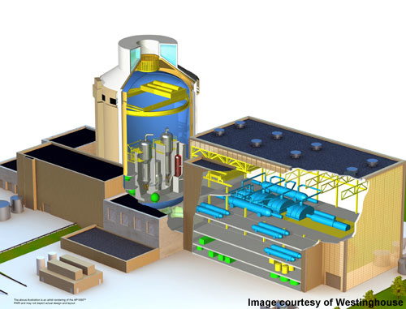
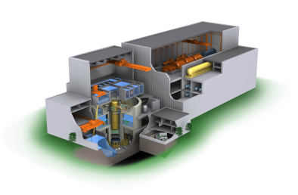
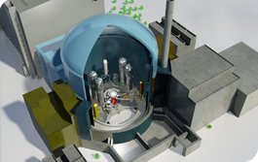
What have we left out?
Instrumentation
Systems for optimizing efficiency
  Control system components used by operators
  Steam system components for thermodynamic efficiency
Equipment to support outages and refueling
Safety Systems

Slide 64
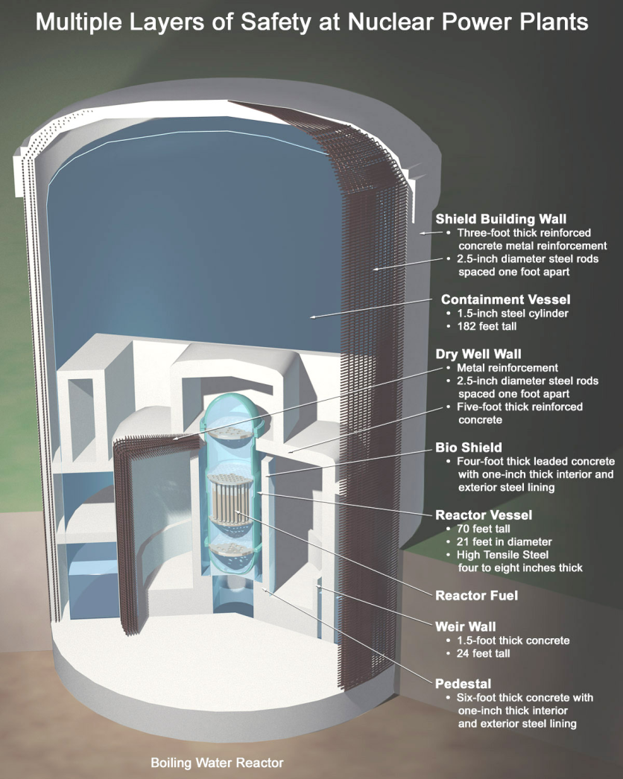
A few words about SAFETY
Two primary safety functions
Contain radioactive material to protect the public
  Many layers of containment
Maintain ability to cool the fuel
  Emergency Core Cooling Systems to move additional cooling water through the core during accident scenarios
  Pumps driven by offsite power
    Backup battery power
    Backup diesel generators

Slide 65
Advanced Reactors
Generation III+ reactors have more safety systems that are driven by natural forces like gravity and natural convection.
  Less susceptible to interruptions in offsite power and less reliant on backup diesel generators
  Small Modular Reactors
Generation IV reactors use alternative coolants such as helium, liquid metals, or molten salts.
  Operate at higher temperatures and offer improved efficiency
  Stronger passive safety features which rely on natural forces
  Enable alternative fuel cycles

Slide 66
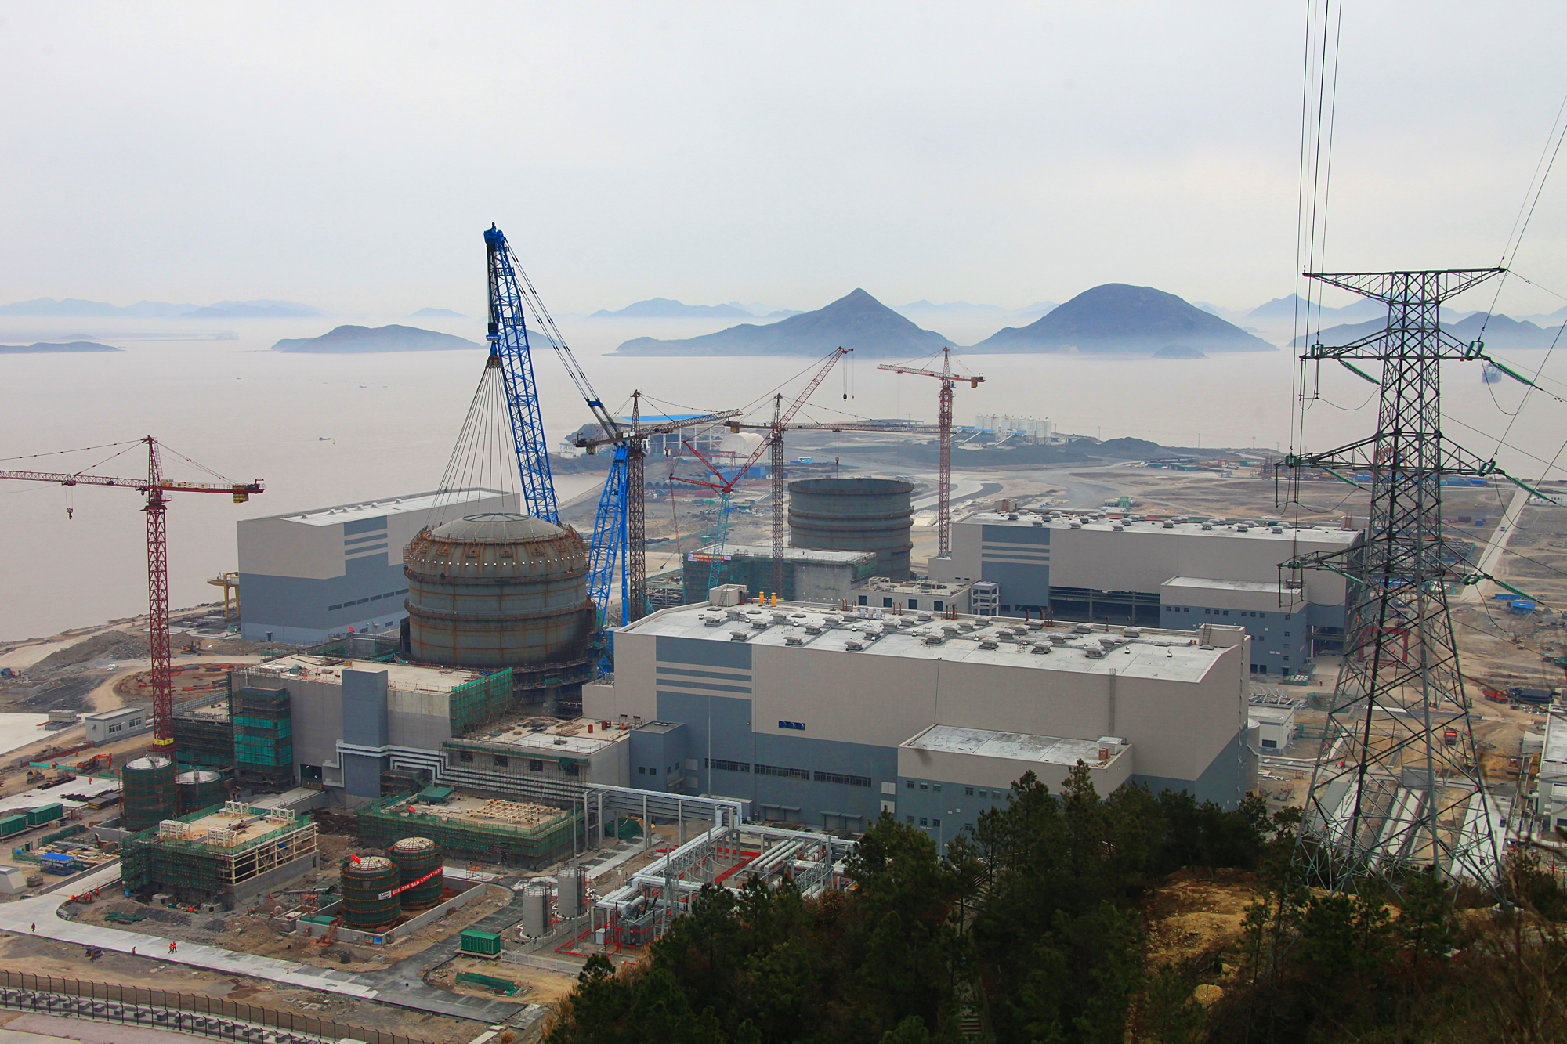
Progress in China – January 29 Photo
Notes:
Picture sourced from http://www.smnpc.com.cn/jszdsmhd/index.jhtml

Slide 67
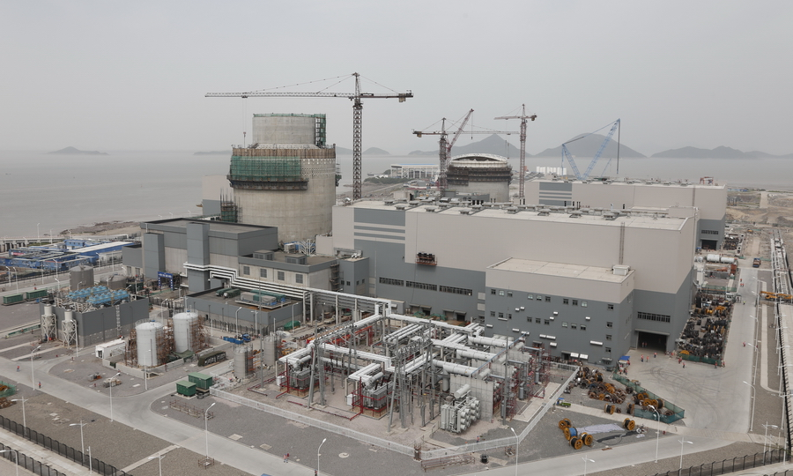
Notes:
Picture sourced from http://www.smnpc.com.cn/jszdsmhd/index.jhtml

Slide 68
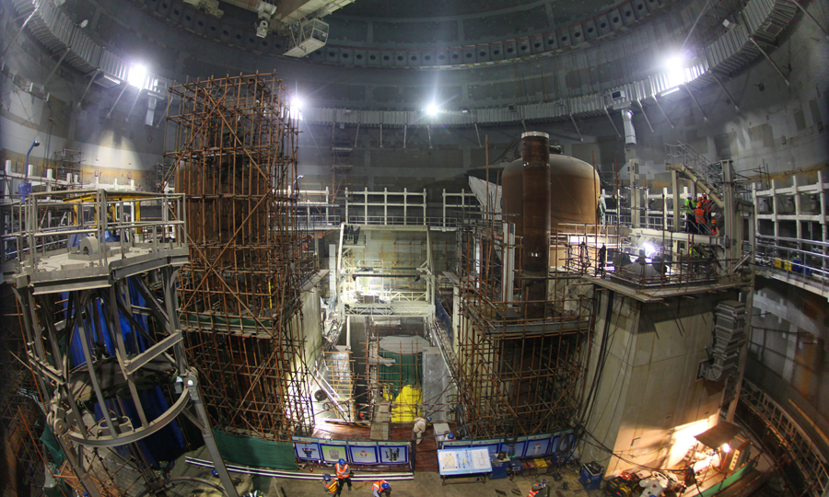
Notes:
Picture sourced from http://www.smnpc.com.cn/jszdsmhd/index.jhtml

Slide 69
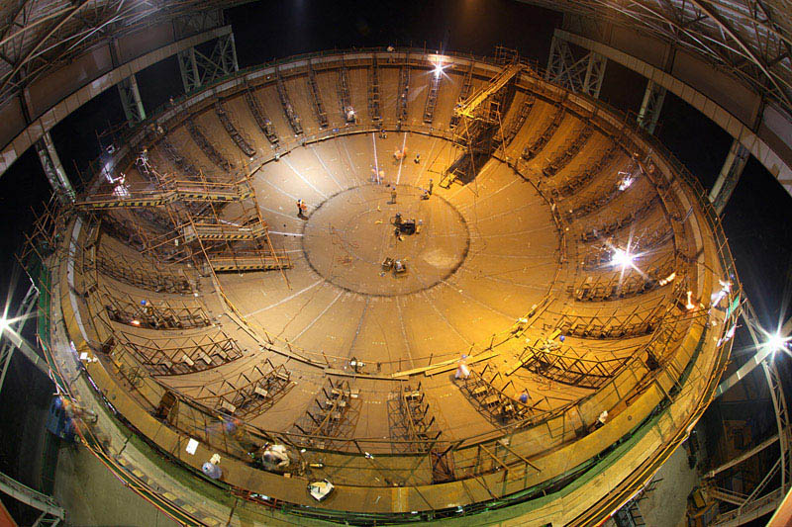
Nuclear Energy 101
Questions?
Notes:
Picture sourced from http://www.smnpc.com.cn/jszdsmhd/index.jhtml

Slide 70
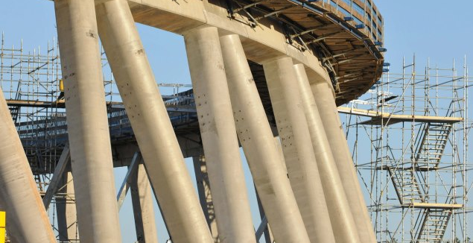
Nuclear Energy 101
Questions?
Notes:
Source unknown

Slide 71
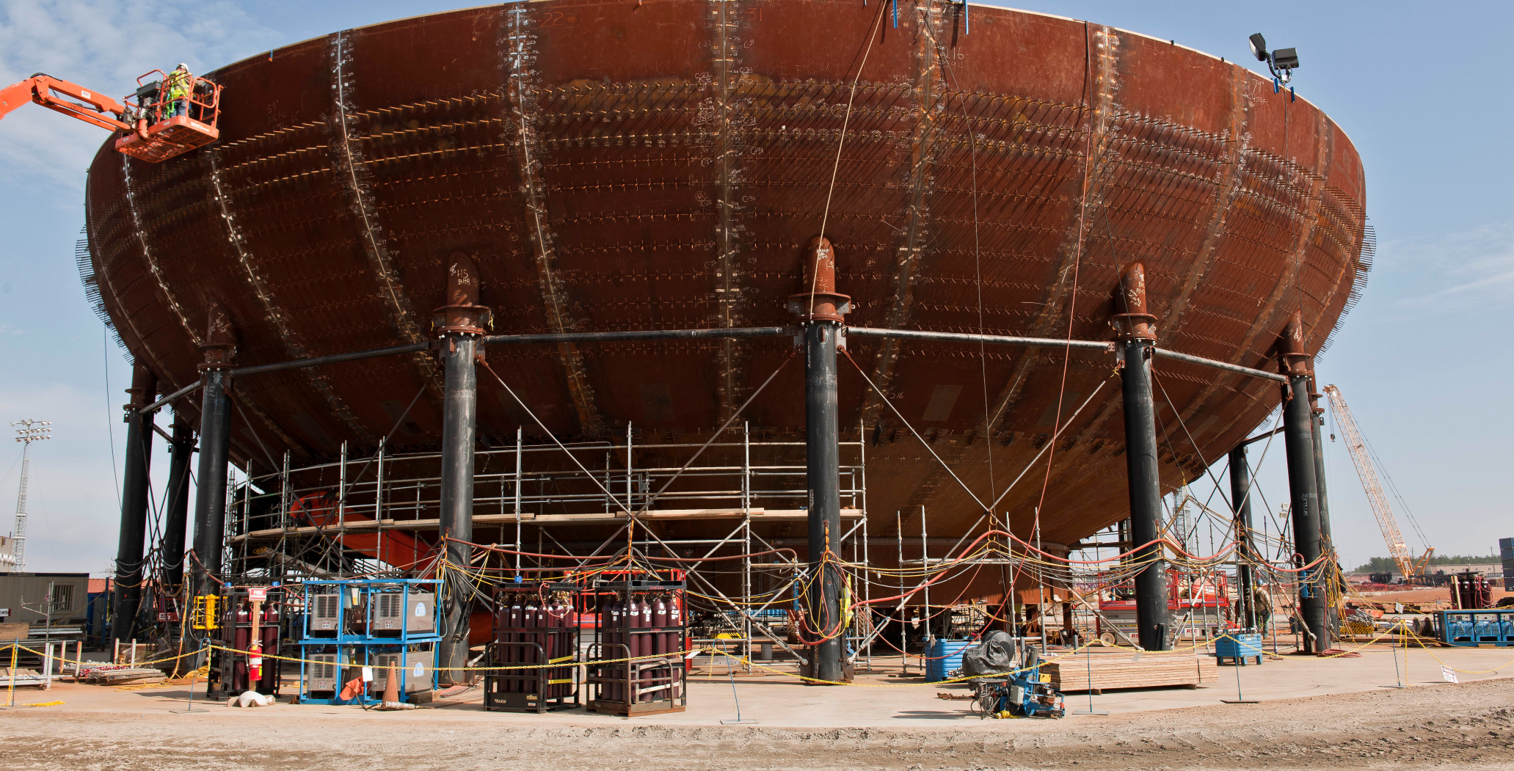
Nuclear Energy 101
Questions?

